Slide 1
CMAC 3990.200 Systems Administration and Operations
Fall 2025 – Week 15.1 – December 2nd, 2025
Presentations

Slide 2

Weekly Info
Go as far as you can see, and you will see further.
Zig Ziglar
Attendance & Good of the class
Assignment 12 – Due This Week!
Friday, November 21st, 2025
Presentation Reminder
Presentation Date: Tuesday, December 2nd, 2025
Assignment 13
Due Friday December 5th, 2025
Assignment AWS - Bonus
Due Friday December 5th, 2025
Remaining Points (637 total):
Attendance (week 15): 6 points
Presentation & Project: 300 points
Assignment 13: 65 points
Final Exam: 266 points
Bonus AWS: 50 points
Final Exam
December 9th, 2025
5:00PM to 7:00PM

Slide 3

Remaining Class Schedule!
Week 15
December 2nd, 2025
Presentations, reviews, and work time
December 4th, 2025
Remaining topics, reviews, discussions, and work time
Automation, IaC, JQ, more…
Week 16 – December 9th, 2025
Final Exam - 5:00PM - 7:00PM

Slide 4

Project
Provide a report and presentation on your chosen topic
Your report and presentation should contain the following:
Describe the standard definitions and terms
Walk through the history of the technology
Walk through what software/hardware you used and how
Documentation, description of services, implementation guide, etc.
References!
Presentation
5-10 minute discussion of your report
Basic implementation – How did you install?
Documentation of steps that can be given to a junior admin!
PowerPoint or another presentation showing steps with pictures will help!
Live examples where possible!

Slide 5
Presentations!
Provide a report and presentation on your chosen topic
Submit all report and presentation materials to D2L “Presentation” assignment folder
Due by the end of the day on Friday, December 5th, 2025.
Presentation
5-10 minute discussion of your report (~20mins max)
Basic implementation – How did you install?
Documentation of steps that can be given to a junior admin!
PowerPoint or another presentation showing steps with pictures will help!
Live examples where possible!
Going to randomize who goes first?
Unless someone wants to go first?

Slide 6
Presentation Time!

Slide 7
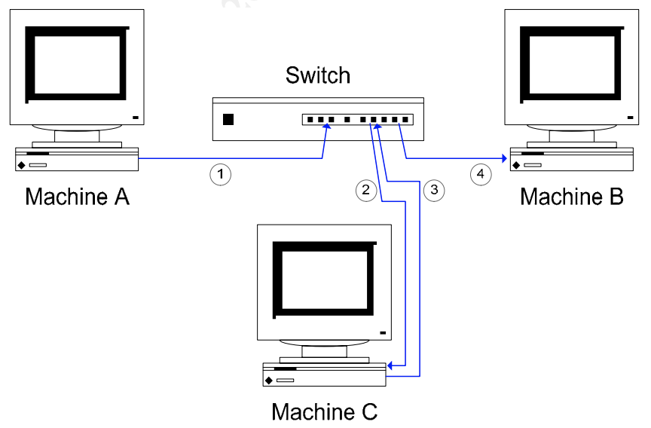
Man in the Middle Attack
Packet Sniffing in a switched environment
https://jpatalon.cs.edinboro.edu/cmac3990/packet-sniffing-switched-environment-244.pdf
MAC flooding, MAC duplicating, ICMP redirection, DHCP spoofing, Port stealing
ARP Spoofing
Taking the example of machines A, B, and C.
Assume C wanted to eavesdrop on network traffic between A and B.
For a man–in-the-middle attack, C pretends to A that it is in fact B.
Then, when A sends traffic destined for B, it is intercepted by C.
C passes this information on to B, pretending that it came from A.
Similarly, C also performs a comparable role for traffic from B, which is destined for A

Slide 8
Man in the Middle Attack
Packet Sniffing in a switched environment
https://jpatalon.cs.edinboro.edu/cmac3990/packet-sniffing-switched-environment-244.pdf
MAC flooding, MAC duplicating, ICMP redirection, DHCP spoofing, Port stealing
ARP Spoofing
The first step is for C to pretend to A that it is in fact B.
If this can be achieved, network traffic destined for B will be routed to C.
Likewise, C must pretend to B that it is in fact A.
How can this be achieved? C “poisons” the ARP cache on A and B.
ARP is a stateless protocol that does not require authentication, so a simple ARP replay packet sent to each host will force an update in their ARP cache.
C sends a spoofed ARP packet to A, instructing A to send packets destined for B to C.
The spoofed ARP packet C sends forces A to update its own ARP cache.
In A’s updated ARP cache, B’s IP address maps to C’s MAC address.
This means future communication from A which is destined for B will go via C.

Slide 9
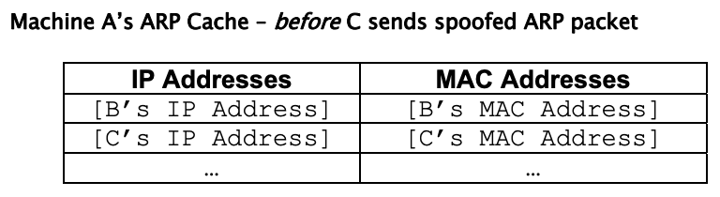
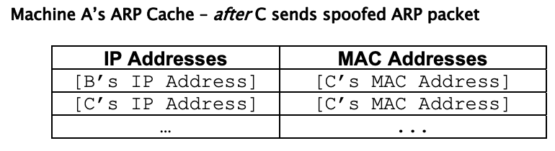
Man in the Middle Attack
Packet Sniffing in a switched environment
https://jpatalon.cs.edinboro.edu/cmac3990/packet-sniffing-switched-environment-244.pdf
MAC flooding, MAC duplicating, ICMP redirection, DHCP spoofing, Port stealing
ARP Spoofing
C also does something similar to B.
It sends a spoofed ARP packet to B, instructing B to update its ARP cache so that A’s IP address maps to C’s MAC address.
Once this has been done, packets that A attempts to send to B are routed to C. Packets that B attempts to send to A are routed to C as well.

Slide 10
Man in the Middle Attack
Packet Sniffing in a switched environment
https://jpatalon.cs.edinboro.edu/cmac3990/packet-sniffing-switched-environment-244.pdf
MAC flooding, MAC duplicating, ICMP redirection, DHCP spoofing, Port stealing
ARP Spoofing
There is one more important step. Machine C also has to ensure that traffic it receives is sent on to its true destination.
So, for example, when A sends traffic destined for B, it is intercepted by C, but sent on from C to B. This can easily be achieved by IP forwarding in many OS’s.
Alternatively, an application can take responsibility for forwarding the traffic to its true destination.
Once a spoofed ARP packet has been sent to a target machine, the attacker will need to re-send this information on a regular basis, to “re-poison” the ARP cache.
This is because operating systems automatically refresh ARP caches on a frequent basis (every 30 seconds is a typical refresh rate).

Slide 11
Man in the Middle Attack
Packet Sniffing in a switched environment
https://jpatalon.cs.edinboro.edu/cmac3990/packet-sniffing-switched-environment-244.pdf
MAC flooding, MAC duplicating, ICMP redirection, DHCP spoofing, Port stealing
ARP Spoofing
An interesting side-effect is made possible through eavesdropping by ARP spoofing/ IP forwarding.
Because we are performing a man–in-the-middle attack, we can alter (add, modify or delete) packets we intercept, or even create new packets.
This enables us to hijack certain types of sessions, telnet, for example.
In addition to sniffing the telnet traffic, we can forge commands made by the client, or replies made by the server.
This enables all sorts of nefarious activities
Forging commands to send password files or other things to the attacker
Session hijacking is not just a theoretical possibility.
Tools such as ettercap and hunt make it simple to achieve.

Slide 12
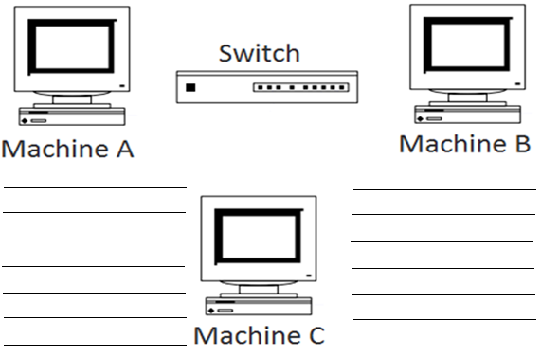
Man in the Middle Attack
Switched Network

Slide 13
CMAC 3990.200 Systems Administration and Operations
Fall 2025 – Week 13.2 – November 20th, 2025
Cloud – DevOps, IaC, Terraform, JQ

Slide 14
DevOPS
DevOPS – A set of practices that automates the processes between software development and IT teams
Allows for rapid building, testing, and deployment
Can deploy new versions of software more often
Create automated testing and review scenarios
Manage infrastructure as code
Git, branching, pull, merge, versioning…
Key items of DevOPS:
Culture – A shift from individual silos to cross-team collaboration
Automation – Remove the possibility of human error, make things repeatable
Lean – Eliminate low-value activities and move quickly, agility, fail fast
Measurement – Show increases in efficiency of new processes, identify areas of improvement
Sharing – Share responsibility between Dev and Ops to grow the teams and increase success rates

Slide 15
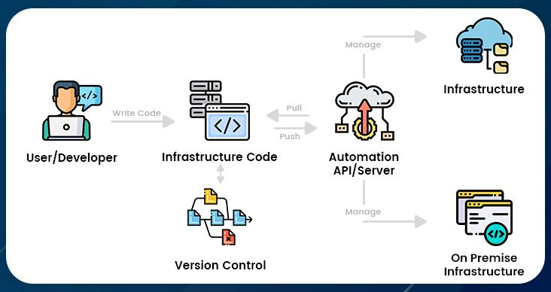
Infrastructure as Code (IaC)
The process of managing and provisioning computer data center resources through machine readable definition files – Wikipedia
Cost, speed, and risk benefits
Reduce manual efforts, remove human error
Automate tasks
Declarative vs. Imperative
Declarative: What the target state should look like
The system executes what needs to happen to reach the desired state
Imperative: How infrastructure is changed
Define specific commands to be executed in the appropriate order
Terraform, Ansible, Puppet, Chef, SaltStack, others…

Slide 16
Infrastructure as Code (IaC)
Hashicorp Terraform
Manage IaC
Declarative
Multi-Cloud Support
Providers
State Management
Maps defined resources to actual resources
S3 bucket, database, or similar
Init, Plan, Apply, Destroy
Easy to install
Hashicorp Repository
Defined naming and coding conventions
File names, file structures, etc.
Free
Terraform

Slide 17
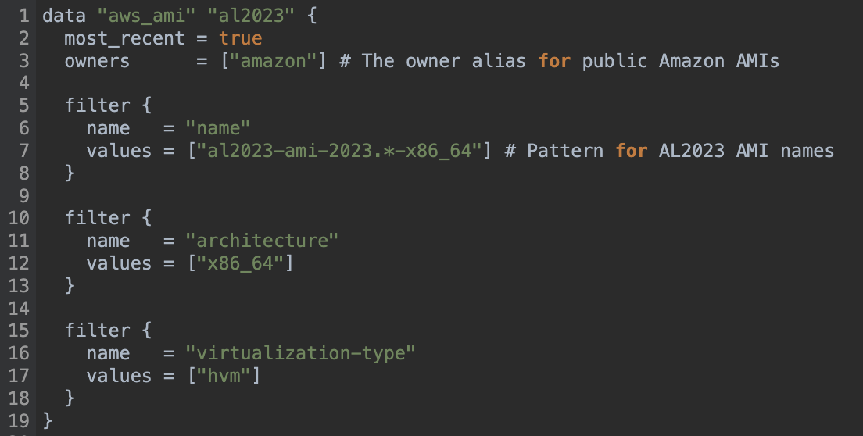
Infrastructure as Code (IaC)
Example – data.tf
Terraform

Slide 18
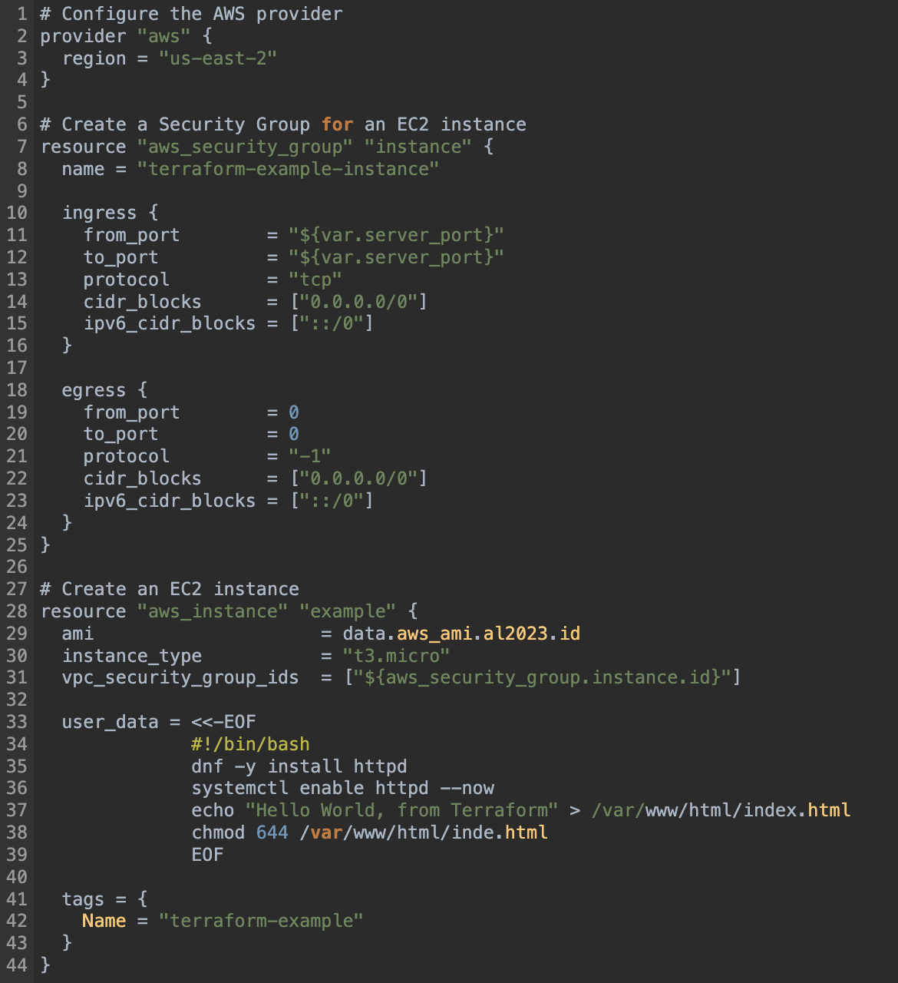
Infrastructure as Code (IaC)
Example – main.tf 1/2
Terraform

Slide 19
Infrastructure as Code (IaC)
Example – main.tf 2/2
Terraform

Slide 20
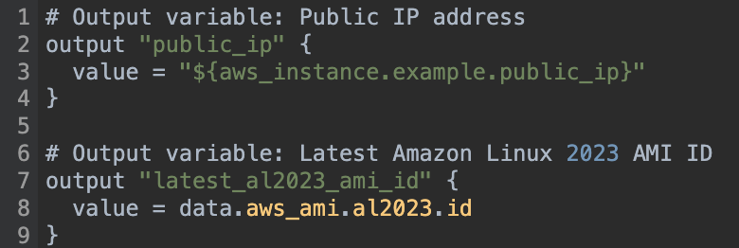
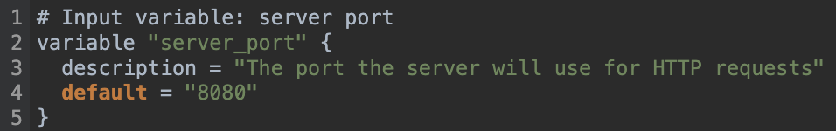
Infrastructure as Code (IaC)
Example – outputs.tf
Example – vars.tf
Terraform

Slide 21

Terraform
Add Hashicorp repository and install Terraform
sudo dnf -y install dnf-plugins-core
sudo dnf config-manager --add-repo https://rpm.releases.hashicorp.com/RHEL/hashicorp.repo
sudo dnf -y install terraform
Ensure you have the aws command line tool installed and configured!
AWS CLI Task from Week 12
aws command
config and credential files
Default region, output format
~/.aws/config file
Access key ID, secret access key
~/.aws/credentials file

Slide 22
Terraform
Download example Terraform code
mkdir -p ~/terraform
cd ~/terraform
curl -O https://jpatalon.cs.edinboro.edu/cmac3990/classfiles/data.tf
curl -O https://jpatalon.cs.edinboro.edu/cmac3990/classfiles/main.tf
curl -O https://jpatalon.cs.edinboro.edu/cmac3990/classfiles/outputs.tf
curl -O https://jpatalon.cs.edinboro.edu/cmac3990/classfiles/vars.tf
Initialize Terraform working directory
terraform init
Download prerequisites
Initialize the backend
Initialize provider plugins

Slide 23
Terraform
Validate
terraform validate
Check that the config is valid
Create a Terraform plan
terraform plan
Compares your current state with your desired state
Generates a plan of action to reach your desired state
Display the plan with the steps to take
Preview what will happen before executing

Slide 24
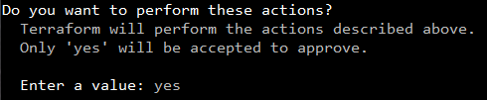
Terraform
Apply the Terraform!
terraform apply
Executes the actions outlined in the plan!
Must confirm and approve the changes!
Cleanup – Destroy everything!
terraform destroy
Deprovision all objects managed by Terraform config
Removes all resources provisioned by the apply command

Slide 25
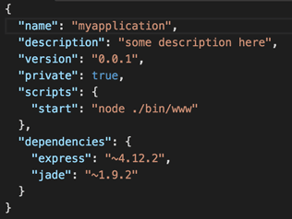

Intro to JSON and JQ
JSON stands for JavaScript Object Notation. JSON is an open standard file format and data interchange format that uses human-readable text to store and transmit data objects consisting of attribute–value pairs and arrays. It is a common data format with diverse uses in electronic data interchange, including that of web applications with servers.
jq is a lightweight, flexible, command-line JSON processor that can slice, filter, and transform the components of a JSON file.

Slide 26
Intro to JSON and JQ
JSON Example Data:
fruits.json:
[
{
"name": "apple",
"color": "green",
"price": 1.2
},
{
"name": "banana",
"color": "yellow",
"price": 0.5
},
{
"name": "kiwi",
"color": "green",
"price": 1.25
}
]

Slide 27
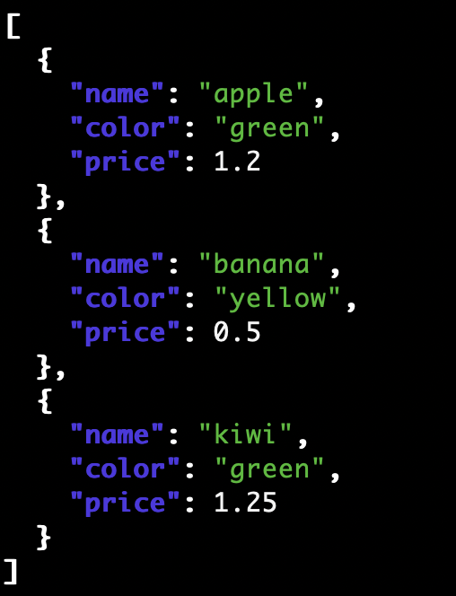
Intro to JSON and JQ
JQ Example usage – Display contents of file and colorize:
jq '.[]' fruits.json

Slide 28
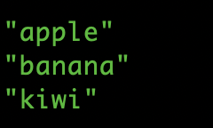
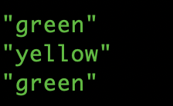
Intro to JSON and JQ
JQ Example usage – Extract just specific data (name, color):
jq '.[].name' fruits.json
jq '.[].color' fruits.json

Slide 29
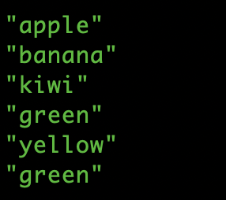
Intro to JSON and JQ
JQ Example usage – Extract just specific data (name and color):
jq '.[].name, .[].color' fruits.json

Slide 30
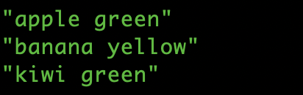
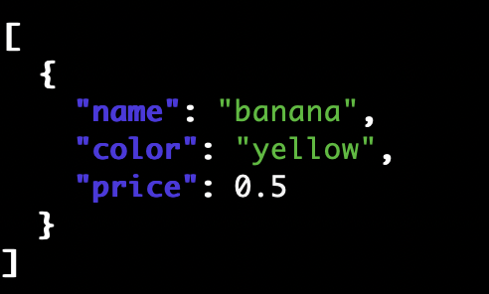
Intro to JSON and JQ
JQ Example usage – Extract just specific data (name with color):
jq '.[] | .name + " " + .color' fruits.json
JQ Example usage – Extract just one items data:
jq 'map(select(.name == "banana"))' fruits.json

Slide 31
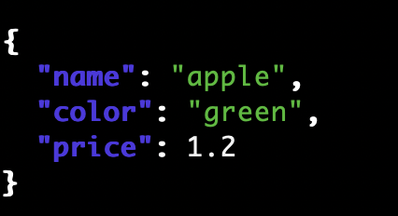

Intro to JSON and JQ
JQ Example usage – Access item by index
jq '.[0]' fruits.json
JQ Example usage – Access item property by index (name)
jq '.[0].name' fruits.json

Slide 32
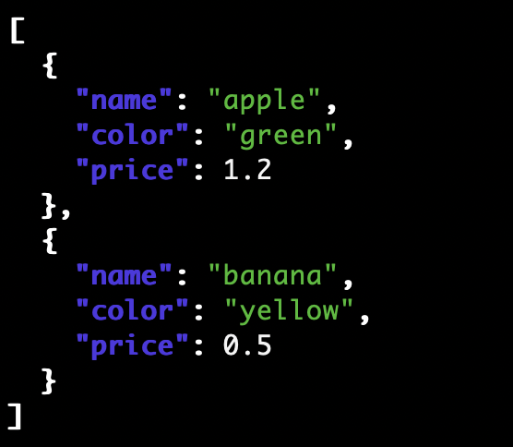
Intro to JSON and JQ
JQ Example usage – Slicing items by index (display elements 0 to 2, excluding item 2)
jq '.[0:2]' fruits.json

Slide 33
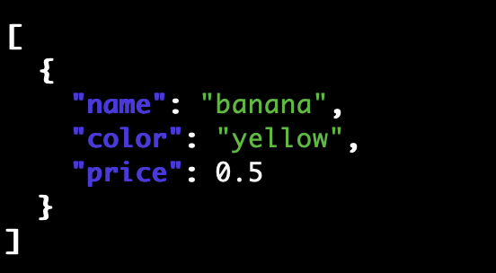
Intro to JSON and JQ
JQ Example usage – Slicing items by index (display 1 element before starting element 2)
jq '.[:2] | .[-1:]' fruits.json

Slide 34
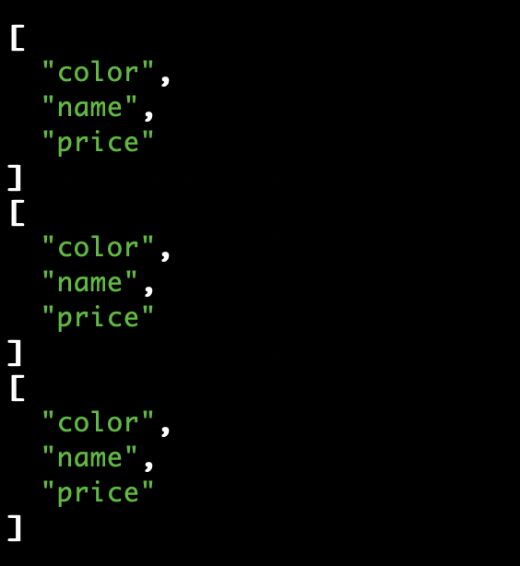
Intro to JSON and JQ
JQ Example usage – Function to get just the names of the keys:
jq '.[] | keys' fruits.json

Slide 35
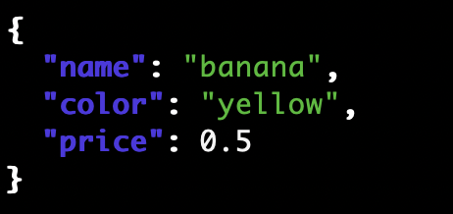
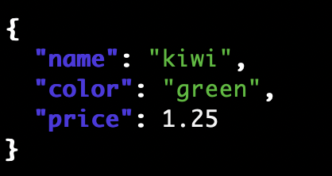
Intro to JSON and JQ
JQ Example usage – Select a specific item
jq '.[] | select(.color=="yellow")' fruits.json
JQ Example usage – Select a items greater than a specific price
jq '.[] | select(.price>1.2)' fruits.json

Slide 36
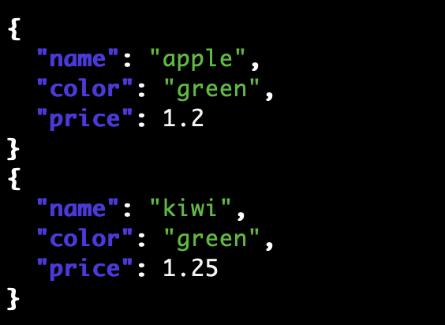
Intro to JSON and JQ
JQ Example usage – Use regex to select items (color begins with g)
jq '.[] | select(.color|test("^g."))' fruits.json

Slide 37
Intro to JSON and JQ
JQ Example usage – Select items matching multiple conditions (specific color and price)
jq '.[] | select(.color=="green" and .price>=1.2)' fruits.json

Slide 38
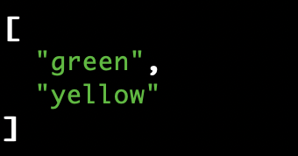
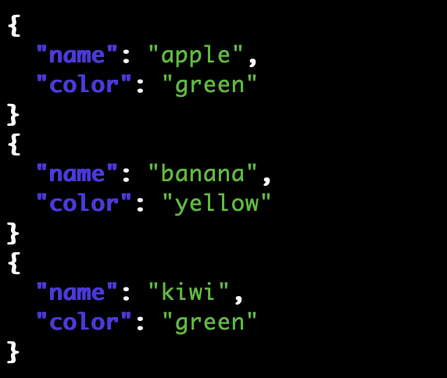
Intro to JSON and JQ
JQ Example usage – Select only unique values (unique colors)
jq 'map(.color) | unique' fruits.json
JQ Example usage – Exclude values from elements (exclude price)
jq 'map(.color) | unique' fruits.json

Slide 39
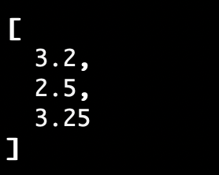

Intro to JSON and JQ
JQ Example usage – Function to add to the price of the fruit
jq 'map(.price+2)' fruits.json
JQ Example usage – Function to find the minimum price
jq '[.[].price] | min' fruits.json
You could also find the max price…

Slide 40
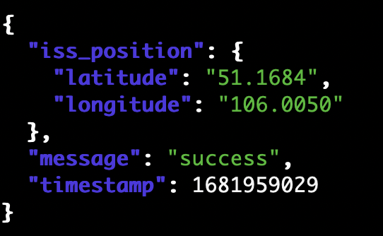
Intro to JSON and JQ
JQ Example usage – Download data with curl and pipe to jq
curl -s http://api.open-notify.org/iss-now.json | jq '.'

Slide 41
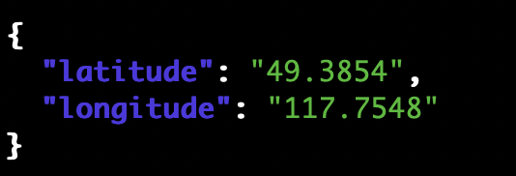

Intro to JSON and JQ
JQ Example usage – Download data with curl and pipe to jq, display specific items
curl -s http://api.open-notify.org/iss-now.json | jq '.iss_position'
JQ Example usage – Download data with curl and pipe to jq, display specific item
curl -s http://api.open-notify.org/iss-now.json | jq '.iss_position.latitude'
Many more examples available online, just ask Google!

Slide 42
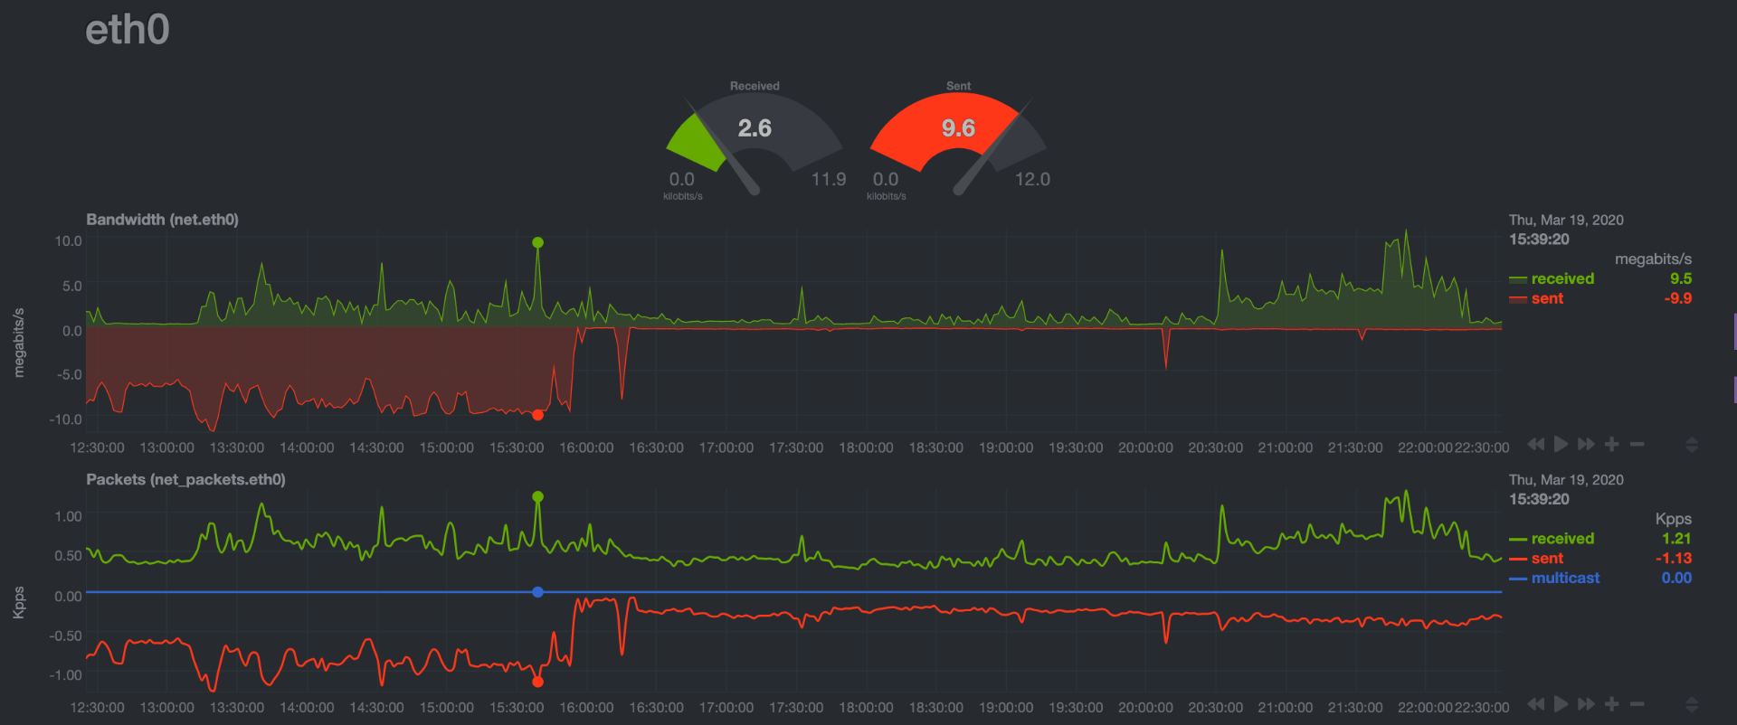
System Analysis and Troubleshooting
Upon a random look at graphs on my system, I notice the following…
Outbound traffic on eth0 is pretty high! Approx 9.6 MBps outbound constantly…
Eth0 is the WAN (internet) interface
Is this normal usage?
Lets take a look at our historical graph…

Slide 43
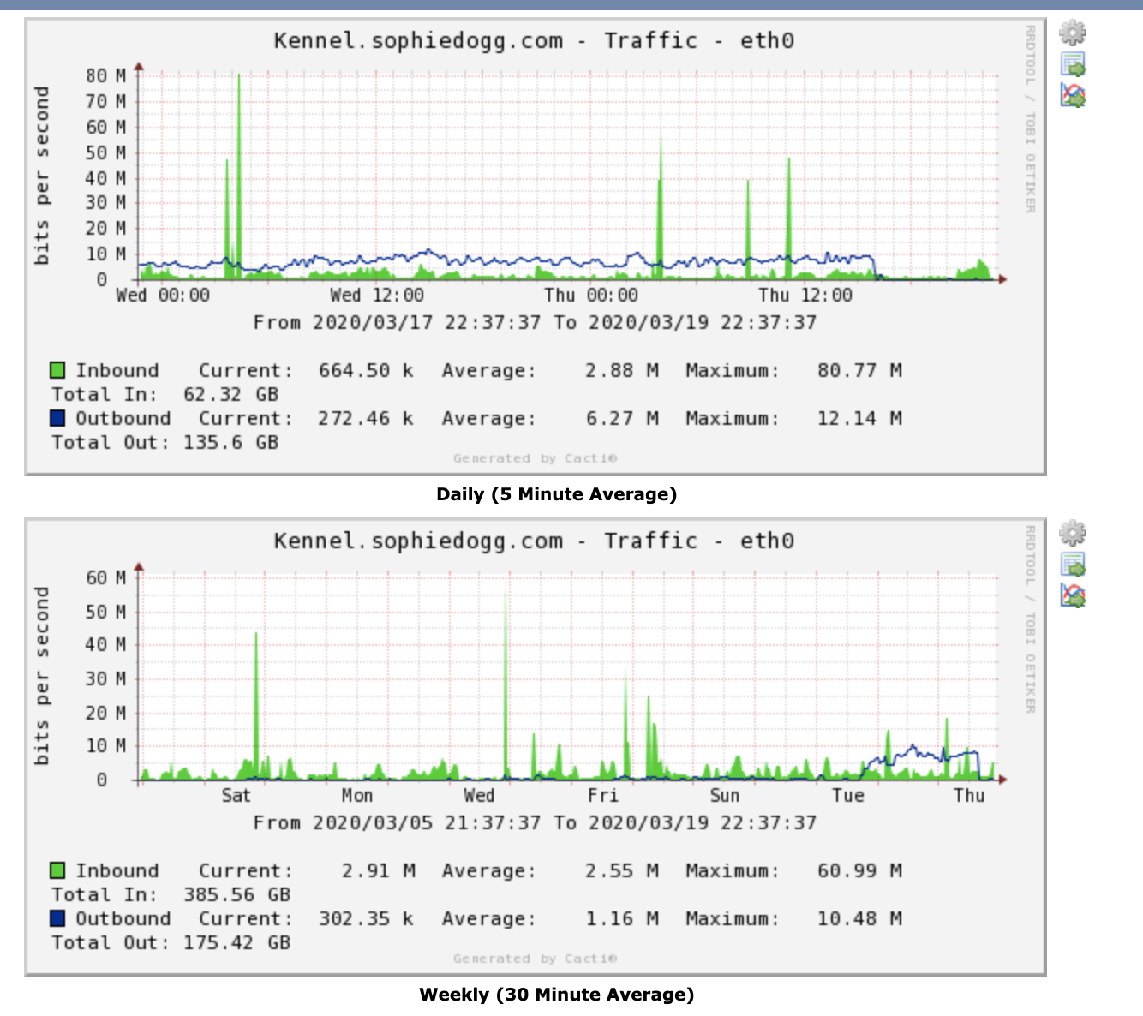
System Analysis and Troubleshooting
Upon a random look at graphs on my system, I notice the following…
Outbound traffic on eth0 is pretty high!
Eth0 is the WAN (internet) interface
Is this normal usage?
Lets take a look at our historical graph…
That looks like it has been sending data for almost a day…
Probably not normal
Let’s investigate further…

Slide 44
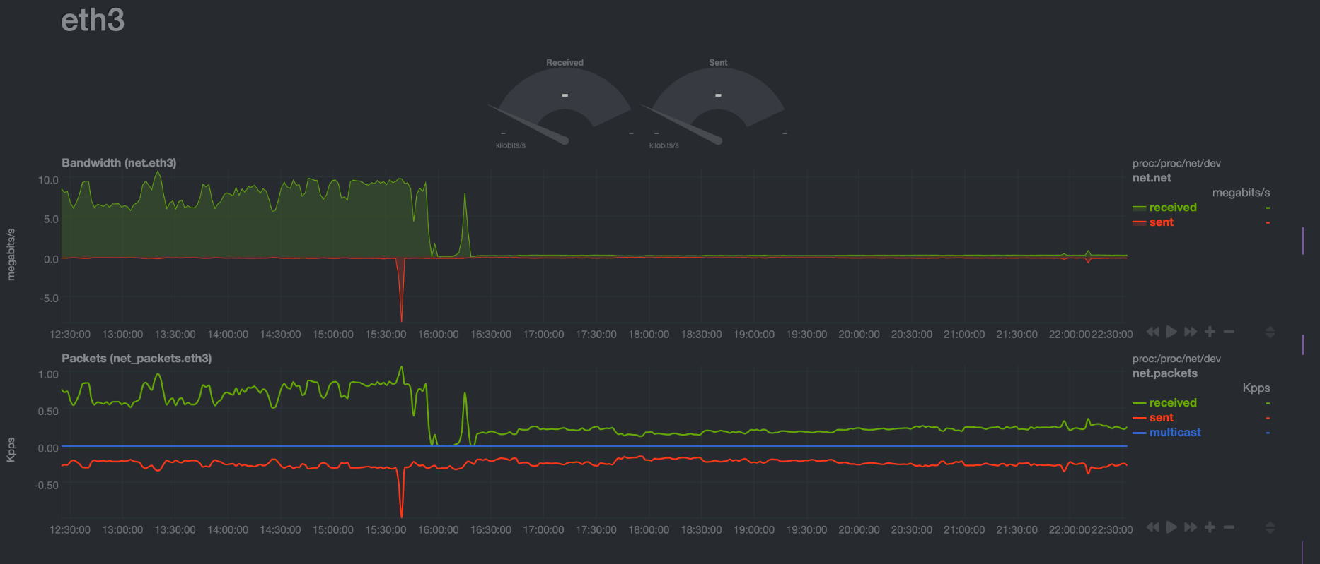
System Analysis and Troubleshooting
Upon a random look at graphs on my system, I notice the following…
Outbound traffic on eth0 is pretty high!
Eth0 is the WAN (internet) interface
Is this normal usage?
Lets take a look at our historical graph…
That looks like it has been sending data for almost a day…
Probably not normal
Let’s investigate further…
Well, that’s a similiar pattern on eth3 (NAS)…

Slide 45
System Analysis and Troubleshooting
Upon a random look at graphs on my system, I notice the following…
Outbound traffic on eth0 is pretty high!
Eth0 is the WAN (internet) interface
Is this normal usage?
Lets take a look at our historical graph…
That looks like it has been sending data for almost a day…
Probably not normal
Let’s investigate further…
Well, that’s a similiar pattern on eth3 (NAS)…
Gotta go read logs…

Slide 46
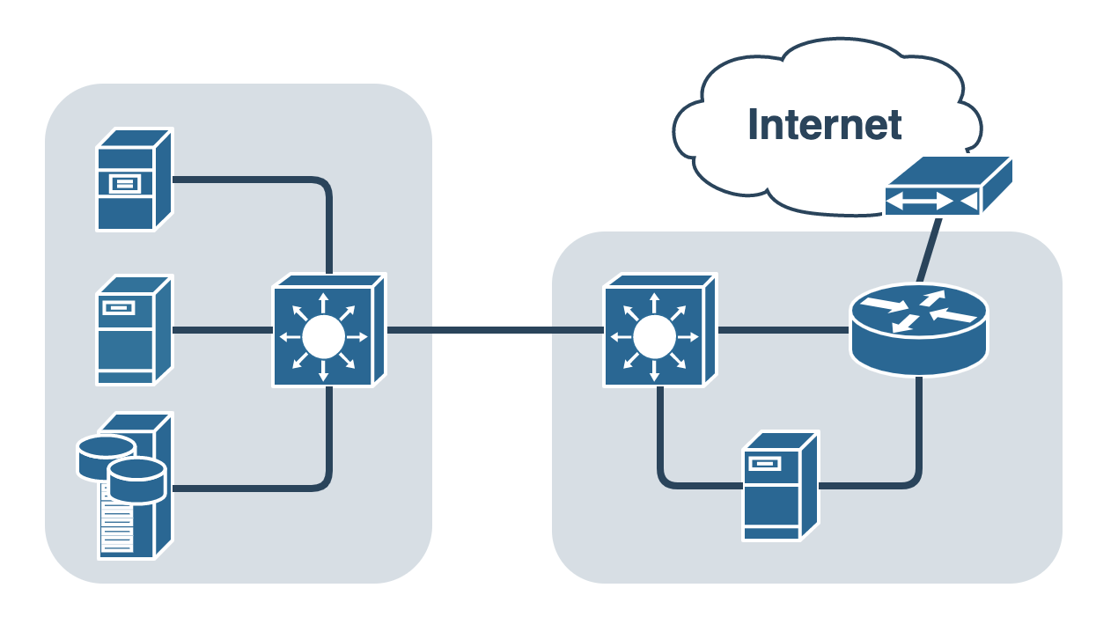
System Analysis and Troubleshooting
Two physical devices
Physical Server
VM Host
SSH Server
VPN Server
File Server
Lots of disks and network cards
DNS, DHCP, NTP, more…
NAS
5 x 10TB disks
Raid 5 array, 1 hot spare
27TB available, 9TB in use
VM Host
Put services in separate VMs!
DNS, DHCP, NTP, more…
DS1019+ NAS
Physical Server

Slide 47
System Analysis and Troubleshooting
Turns out this was a DNS redirection DDOS attack!
I had recently moved my DNS services to a new VM running on my NAS device (on eth3)
I previously would forward all DNS requests to my new internal DNS server
This DNS server performed authoritative responses for my personal subdomains
This DNS server also performed non-authoritative recursive DNS resolution for clients on my local network
The forwarding rules I put in place for DNS forwarding to the internal VM perform IP Masquerading (NAT) on incoming addresses
To my internal DNS server, the forwarded requests from the internet appear to come from the router’s local IP address!
Can you guess what happens next?!
DS1019+ NAS
Physical Server

Slide 48
System Analysis and Troubleshooting
Turns out this was a DNS redirection DDOS attack!
I had recently moved my DNS services to a new VM running on my NAS device (on eth3)
I previously would forward all DNS requests to my new internal DNS server
This DNS server performed authoritative responses for my personal subdomains
This DNS server also performed non-authoritative recursive DNS resolution for clients on my local network
The forwarding rules I put in place for DNS forwarding to the internal VM perform IP Masquerading (NAT) on incoming addresses
To my internal DNS server, the forwarded requests from the internet appear to come from the router’s local IP address!
My private internal server became an open DNS resolver!
https://www.cloudflare.com/learning/ddos/dns-amplification-ddos-attack/

Slide 49

Lessons Learned
Consistency? Clarity?
Expectation vs. reality?
Opportunities for improvement?
Better combined with 325 related topics
Remove duplicate discussions/info
More cloud? Better organized?
Another 1-2 weeks of content
We cancelled one class, some classes were short…
Move VMs to cloud!
Review all IP addresses for consistency!
Version numbers on assignments to match scripts?
3 digit student numbers?
No presentations?

Slide 50

Assignments 11-13, AWS
Assignment 11 – 63 points – Due November 14th, 2025
Survey and Questionnaire
https://jpatalon.cs.edinboro.edu/cmac3990/Assignment%2011.pdf
Assignment 12 – 72 points – Due November 21st, 2025
Network updates, Switch to Docker-CE, OwnCloud vs. NextCloud, Disk updates
https://jpatalon.cs.edinboro.edu/cmac3990/Assignment%2012.pdf
Assignment 13 – 65 points – Due December 5th, 2025
Final additional/related tasks – good for review…
https://jpatalon.cs.edinboro.edu/cmac3990/Assignment%2013.pdf
Assignment AWS – 50 points bonus – Due December 5th, 2025
AWS CLI deployment
https://jpatalon.cs.edinboro.edu/cmac3990/Assignment%20AWS.pdf

Slide 51
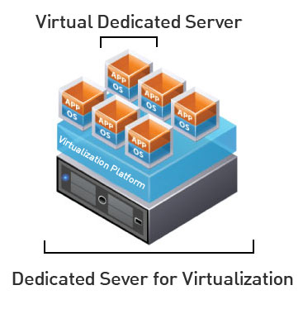
Virtual Machines
VM Info:
IP Address: 147.64.243.1##/23 (01-20) – bond0
Hostname: cmac3990-1##.cs.edinboro.edu (01-20)
Alias: 41##.megastuff.biz (01-20)
Samba: \\147.64.243.1##\ (01-20)
Interfaces:
Enp1s0, enp8s0, enp9s0, enp10s0, mybond0, mybond0.6, mybond0.110, mybond0.187
IP’s
mybond0 – 147.64.243.1## & 147.64.243.150+##/23
mybond0.6 – fd06:1234:5678:beef:1##::1/64
mybond0.110 – 10.10.1##.1/16
mybond0.187 – 10.1.187.1##/22
Additional IP’s…
mybond1 – 192.168.1.1##/24 & 192.168.1.2##/24 & fd06:8765:4321:face:1##::1/64
mybond1.399 – 192.168.1##.25/19
mybond1.222 – 10.222.222.2##/22

Slide 52
Virtual Machines
IP Address: 147.64.243.1## (01-15)
Hostname: cmac3990-1##.cs.edinboro.edu (01-15)
Alias (01-15):
##.megastuff.biz
1##.megastuff.biz
41##.megastuff.biz (subdomain)
SOA, NS, A, MX
www, ipv6, newprivate1, private2, midterm1-4?
Nextcloud.1##.megastuff.biz
Owncloud.1##.megastuff.biz
We didn’t really use these aliases

Slide 53

Linux Commands
nmap
ping
mkdir
rsync
crontab
tshark
aws

Slide 54

Key Terms and Items
Cloud
AWS
EC2
Security Groups
Elastic Load Balancer
Auto Scaling Groups
Scaling Policies
Launch Templates
Target Groups
Keys

Slide 55

For Next Week
Just Do It
Nike
December 5th, 2025
All assignments due by the end of the day!
December 9th, 2025
Final exam
All outstanding submissions due
Partial credit may be given for any late assignments…

